Slide 1

Make I.T. Happen
The City of Dublin’s Workforce Development Strategy
Rachel Ray
Economic Development Administrator
May 9, 2018

Slide 2


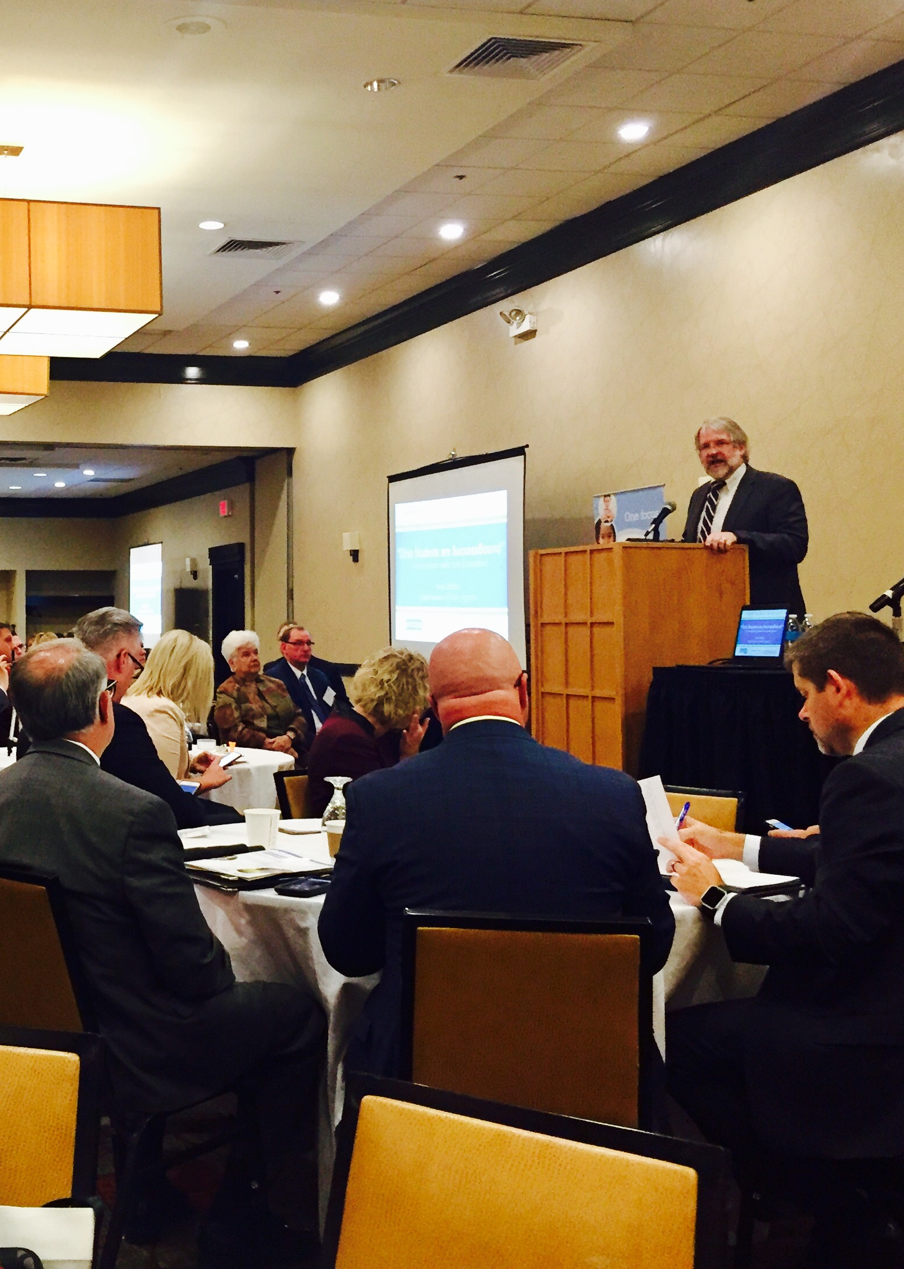
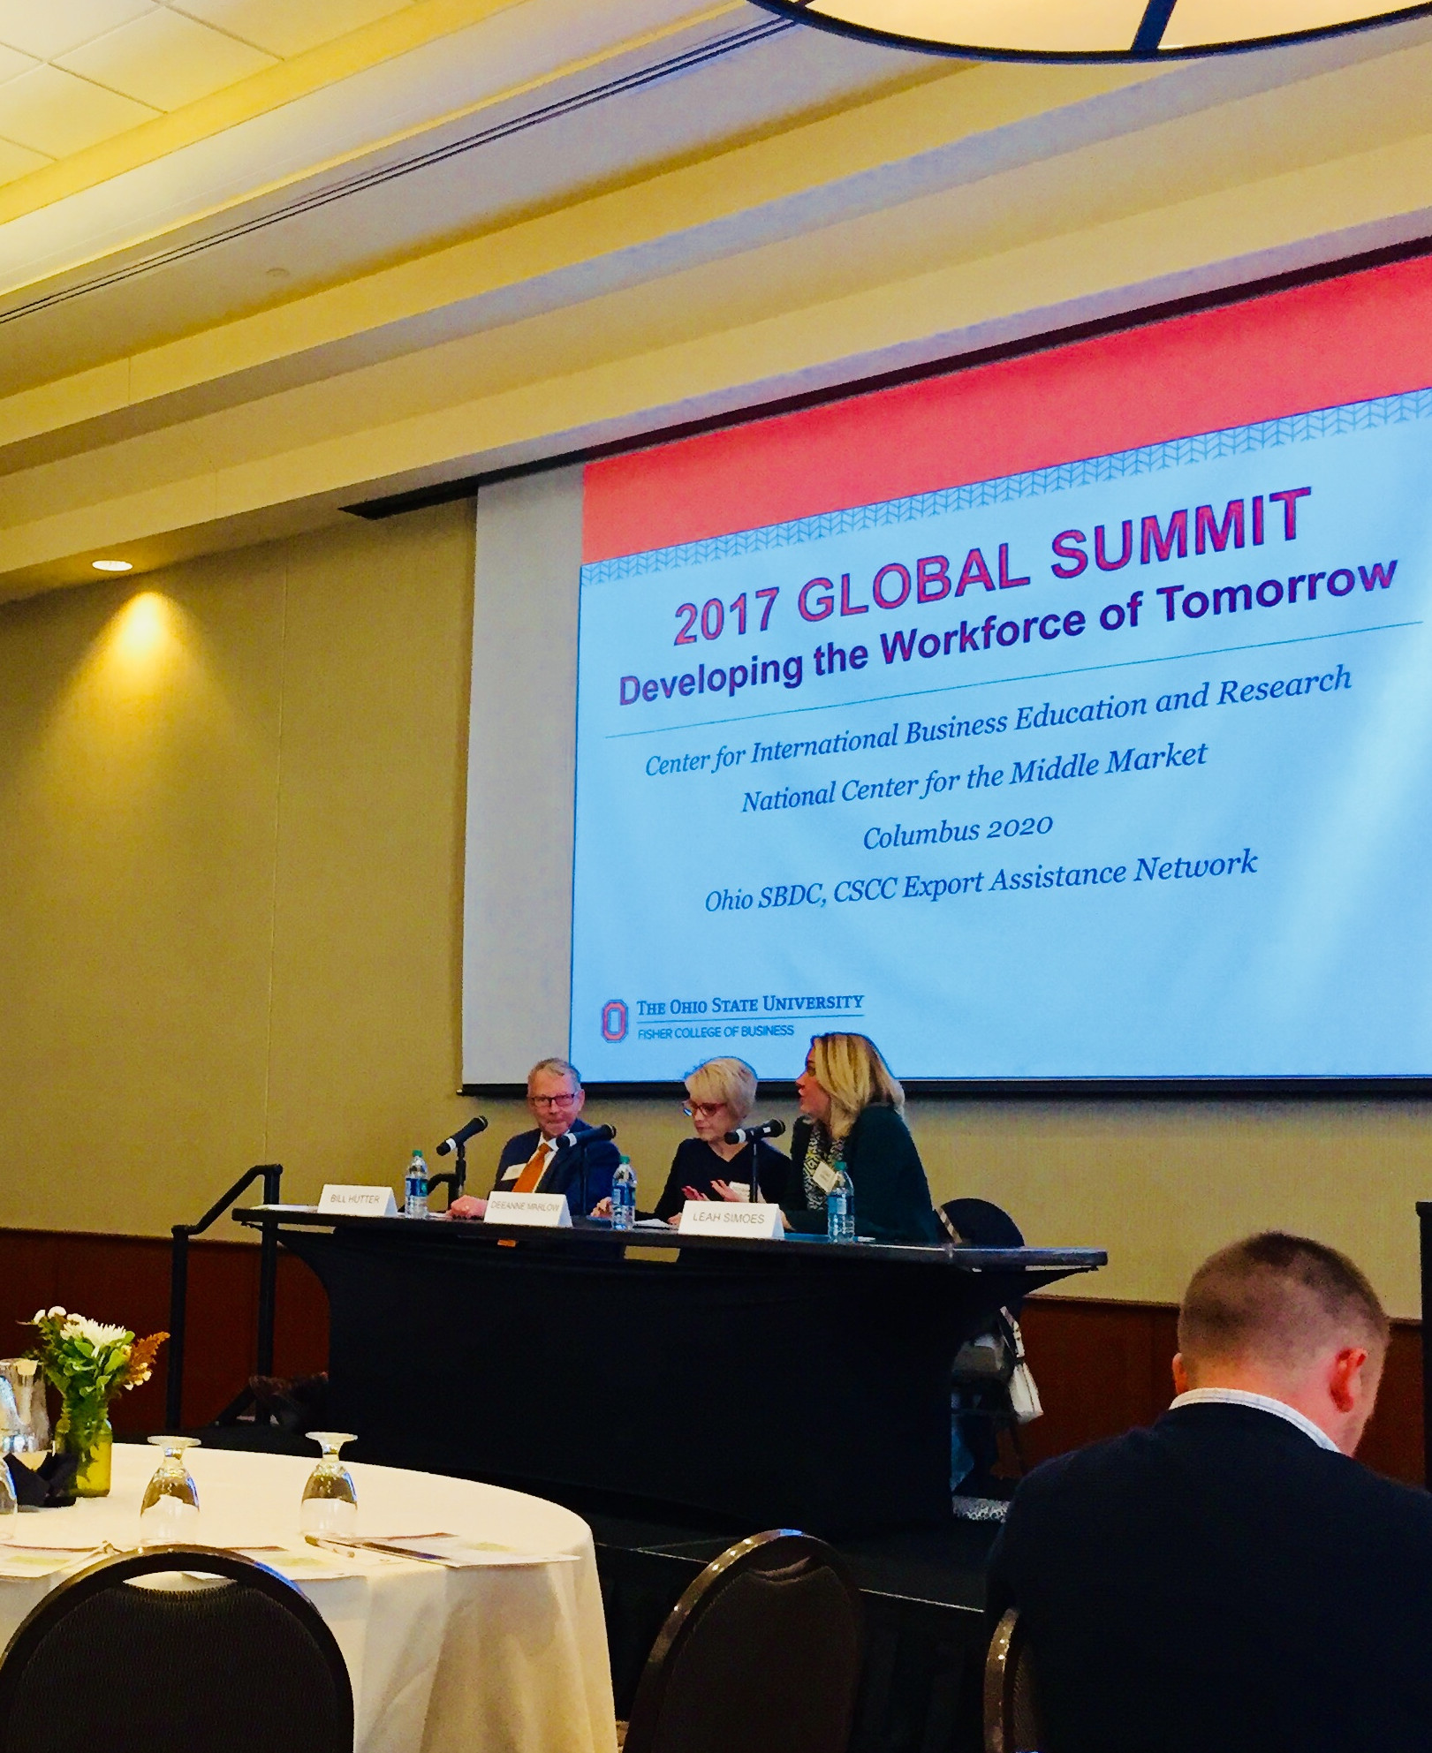
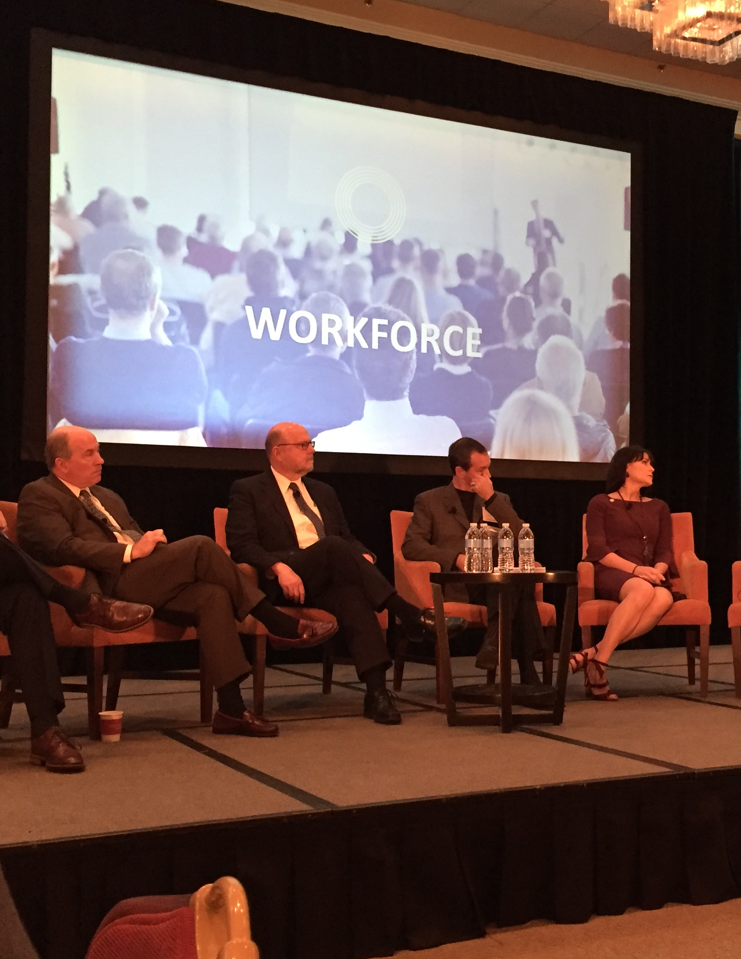

Slide 3
Key Messages: How Does Dublin Make I.T. Happen?
Focus
Small Wins
Try something!
How?

Slide 4


Key Messages: How Does Dublin Make I.T. Happen?
Find your community’s workforce development champion(s).
If you don’t know where to start, start with your local Economic Development partners.
http://columbusregion.com/columbus-2020/state-local-partners/mode/mode-membership/

Slide 5


SuccessBound Communities
SuccessBound communities communicate with schools about the needs of the local economy.
They actively foster collaboration between schools and businesses to help grow the local workforce.
Economic Development is a key ingredient in this relationship.
Retention
Expansion
Attraction
Creation
Workforce
Five Pillars of Economic Development
Economic Development

Slide 6
Workforce: the #1 Location Decision Driver
What Matters Most:
Site Selector's Most Important Location Criteria
Source: Site Selection survey of corporate real estate executives, October 2017
1 | Workforce skills
2 | Transportation infrastructure
3 | Utilities (cost, reliability)
4 | State and local tax scheme
5 | Land/building prices and supply
6 | Quality of life
7 | Workforce development
8 | Ease of permitting and regulatory procedures
9 | Incentives
10 | Higher education resources
Economic Development

Slide 7
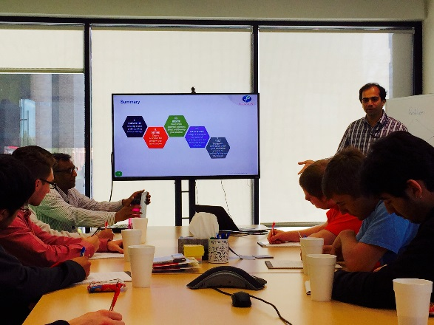
Business Retention & Expansion Visits
Retention rates
Specific skills required, and how they’re impacted by evolving technologies
Job descriptions
Company culture
Recruitment resources
Alignment of talent and business development strategies
Economic Development

Slide 8
Dublin Industry Clusters – 2015 Battelle Study
Bioscience & Healthcare Services
  Dublin Methodist Hospital, Express Scripts, Humana, LabCorp, Ohio University Heritage College of Osteopathic Medicine, Smiths Medical
Financial Services/Business Support Services
  Garden City Group, Henry Schein Animal Health, HKT Teleservices, Sedgewick CMS, Wilke Global, United Healthcare Group
Corporate HQs & Managing Offices
  Ashland, Cardinal Health, CareWorks Family of Companies, Delta Energy, IGS, Nestle Quality Assurance Center, OCLC, The Wendy’s Company
Internet Commerce & Computer Services
  Cisco, Dark Rhino Security, DXC, Exact Macola, Expedient, Fast Switch, Fiserv, HP Enterprise Group, Illumination Works, Infoverity, Leading Edje, Metro Data Center, Northwoods, OCLC, Persistent Systems, Presidio, Sedgwick, T-CETRA, TEKsystems, The Fuse, Total Sim, Veeva Systems, Velosio, VirtusaPolaris
Economic Development

Slide 9
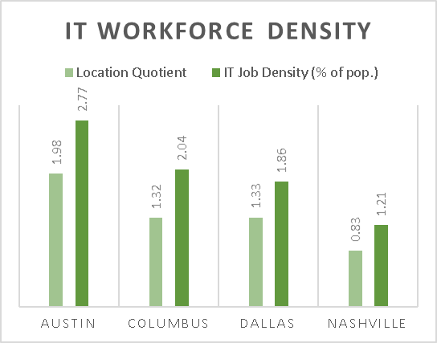
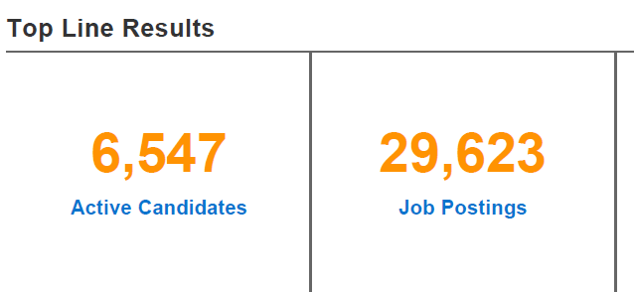
Why IT?
Dublin Location Quotient
Computer & Information Systems Managers
  vs. US – 2.98
  vs. OH – 3.10
< 1 = Below Average
1 = National Average
> 1 = Above Average
Central Ohio IT Industry
Source: Burning Glass, Dec. 2017
Economic Development

Slide 10
Solution Hypothesis
Sponsor the creation of a web-based training platform to train coders/software developers.
No Thanks!
Economic Development

Slide 11
RESEARCH REVEALED THREE PRIMARY NEEDS
Talent recruitment and retention support
Training cost support
Access to several specific training topics
Economic Development

Slide 12

Our Vision:
Make Dublin a Midwest IT Magnet
Focus

Slide 13
Our Goal:
To enhance workforce retention, attraction, and employee engagement and make a positive impact on company’s bottom line.
Focus

Slide 14
Strategy
Dublin Speaker Series – Best practices & Networking
Soft Skills are the Hard Skills – Leadership Development
Cost Mitigation – Bottom Line Impact
Increase the Talent Pipeline – Attracting New Talent & Developing New Talent Resources
Focus

Slide 15


What’s in it for companies?
Active participation and ownership is vital to ensuring the success of this workforce development initiative for businesses.
Focus

Slide 16
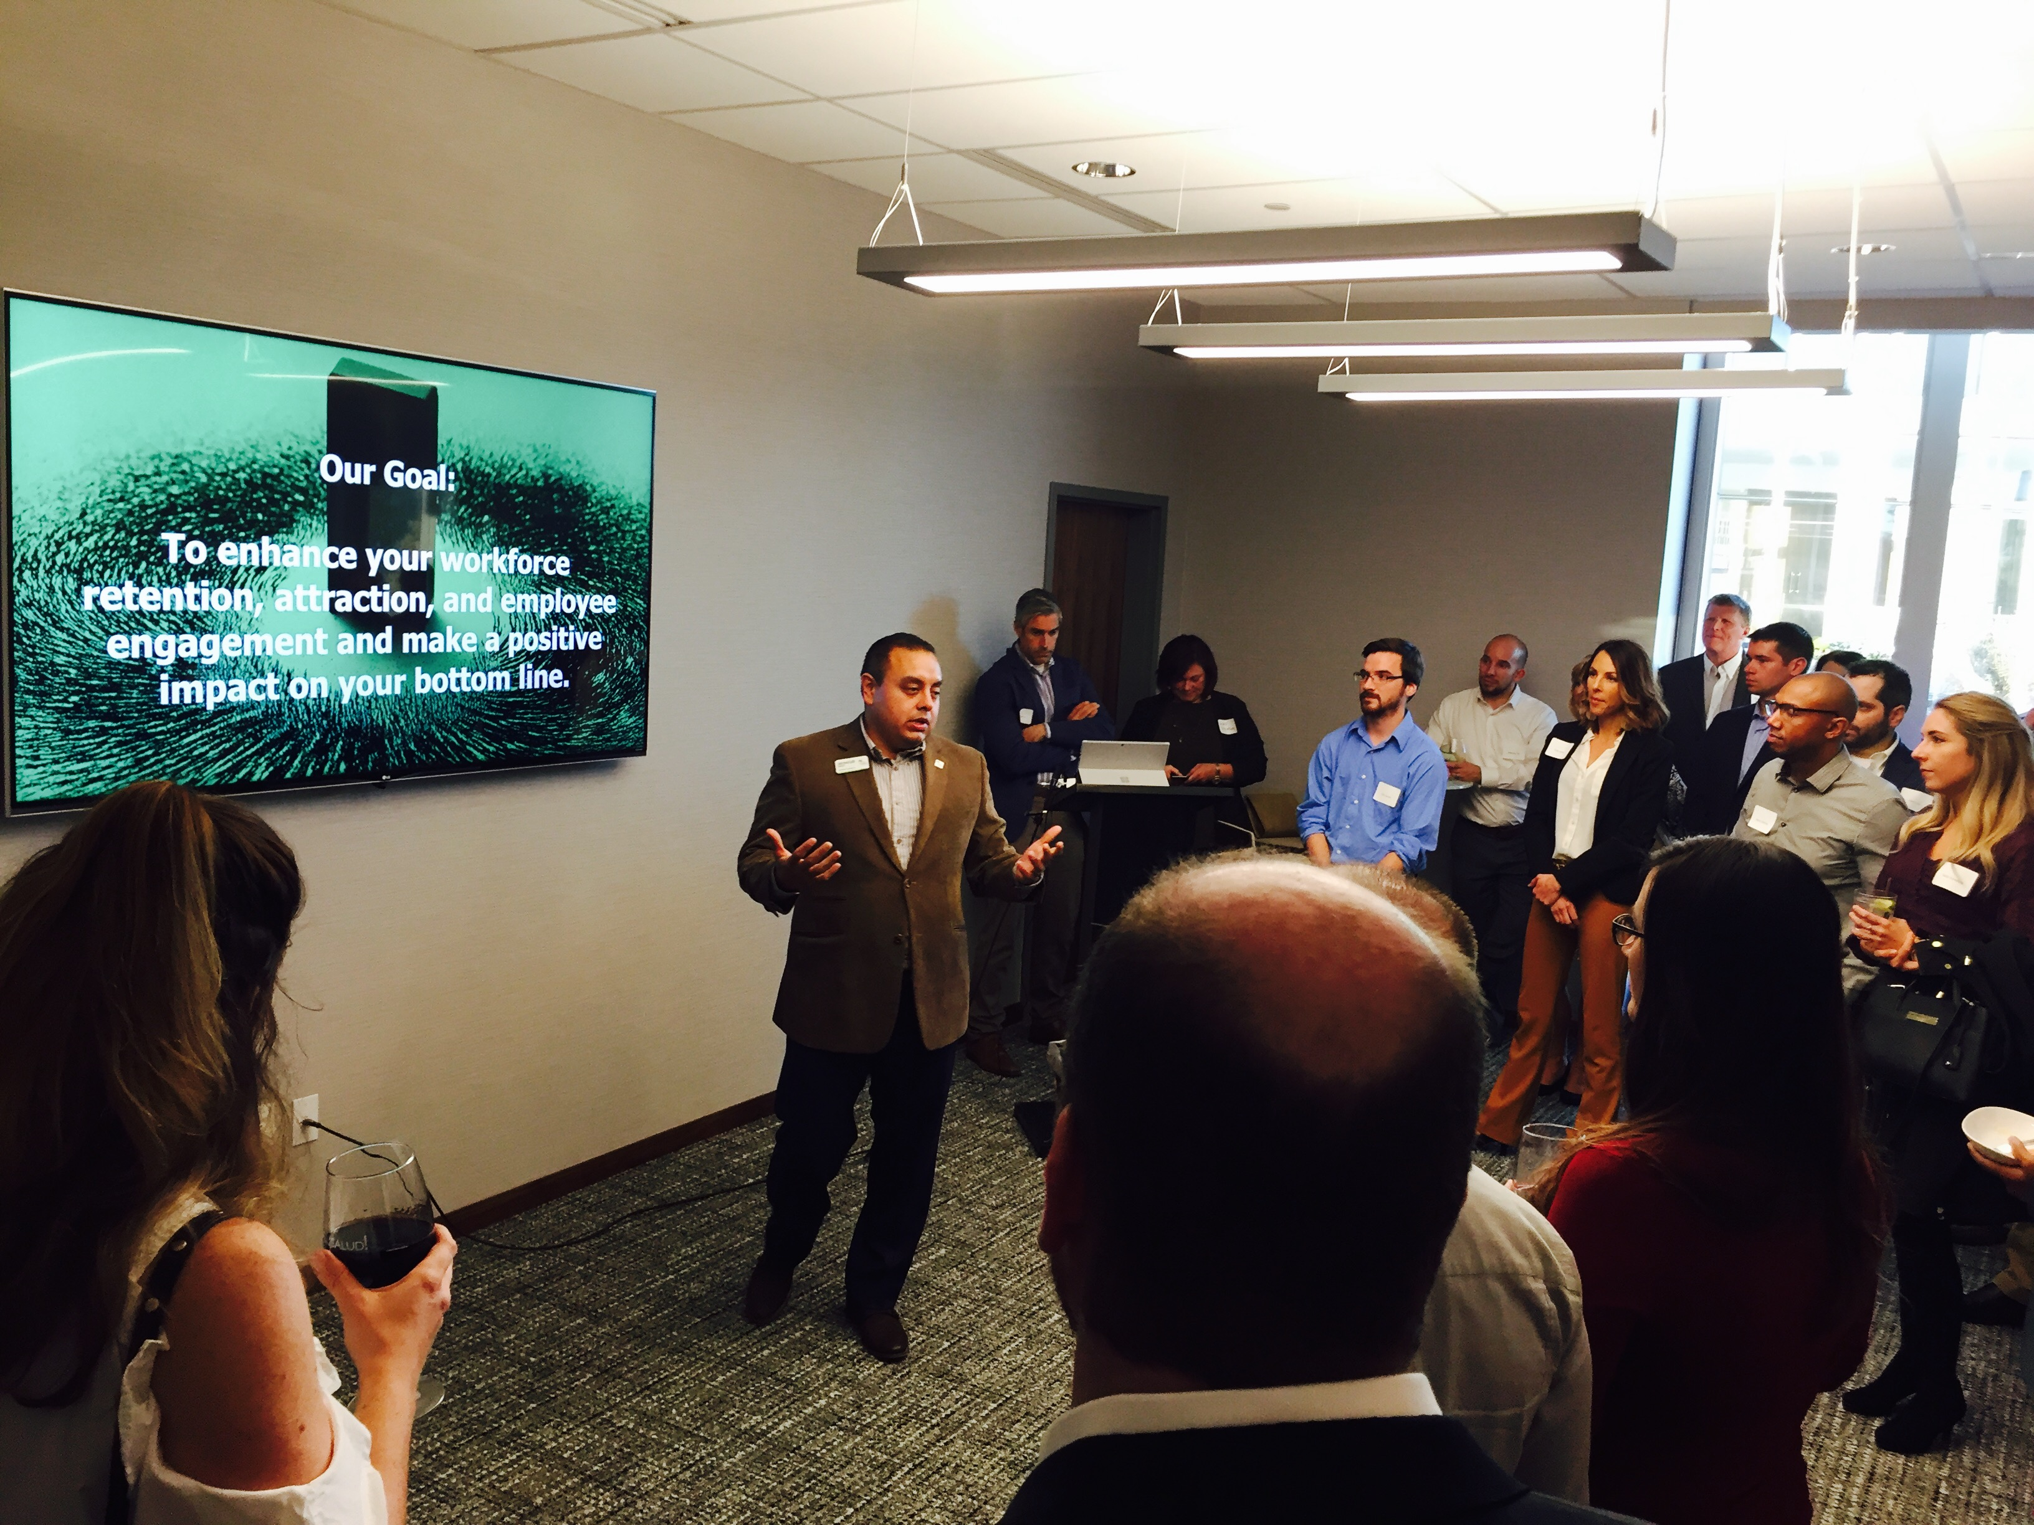
1) Dublin Speaker Series
Create Dublin Speaker Series: Leverage Dublin’s thought leaders
Culture improvement and training: Create reputation of incredible business culture in Dublin.
Talent recruitment and retention: Assist companies with talent retention, recruitment, and professional development.
Best Practices & Networking
Focus

Slide 17








2) Soft Skills are the Hard Skills
Focus

Slide 18

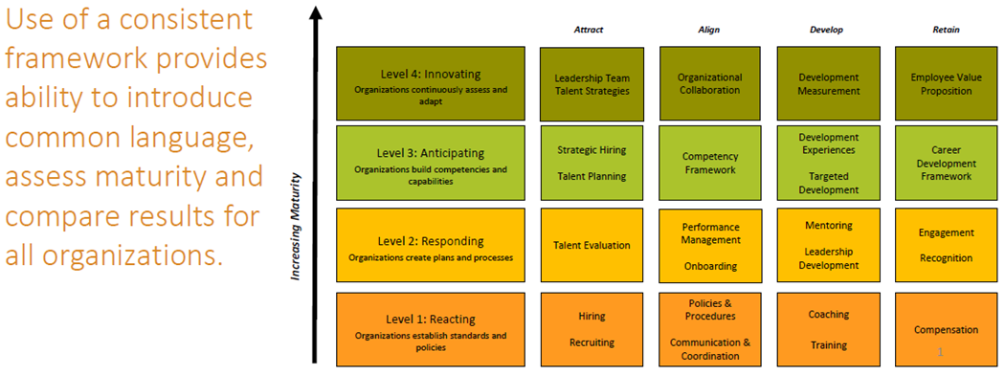
3) Cost Mitigation – Workforce Assessments
Focus

Slide 19
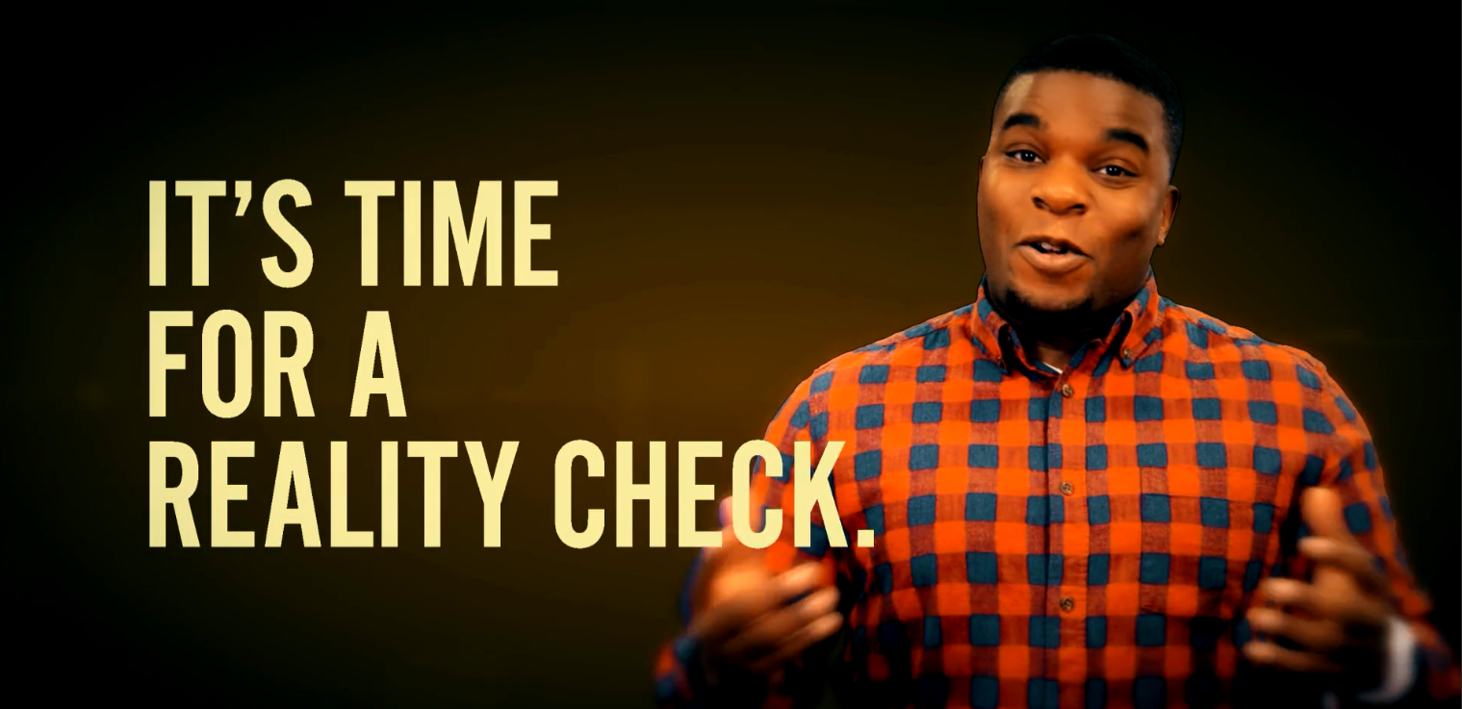
4) Increase the Talent Pipeline
Digital marketing campaign
Builds awareness
Highlights Dublin as a fast-growing hub for tech companies
Image from Dublin Economic Development’s Video Ad Campaign targeting
talented workers via LinkedIn, social media in east coast/west coast markets
Focus

Slide 20
Strategy
Dublin Speaker Series – Best practices & Networking
Soft Skills are the Hard Skills – Leadership Development
Cost Mitigation – Bottom Line Impact
Increase the Talent Pipeline – Attracting New Talent & Developing New Talent Resources
How do we know
we’re “winning”?
Focus

Slide 21
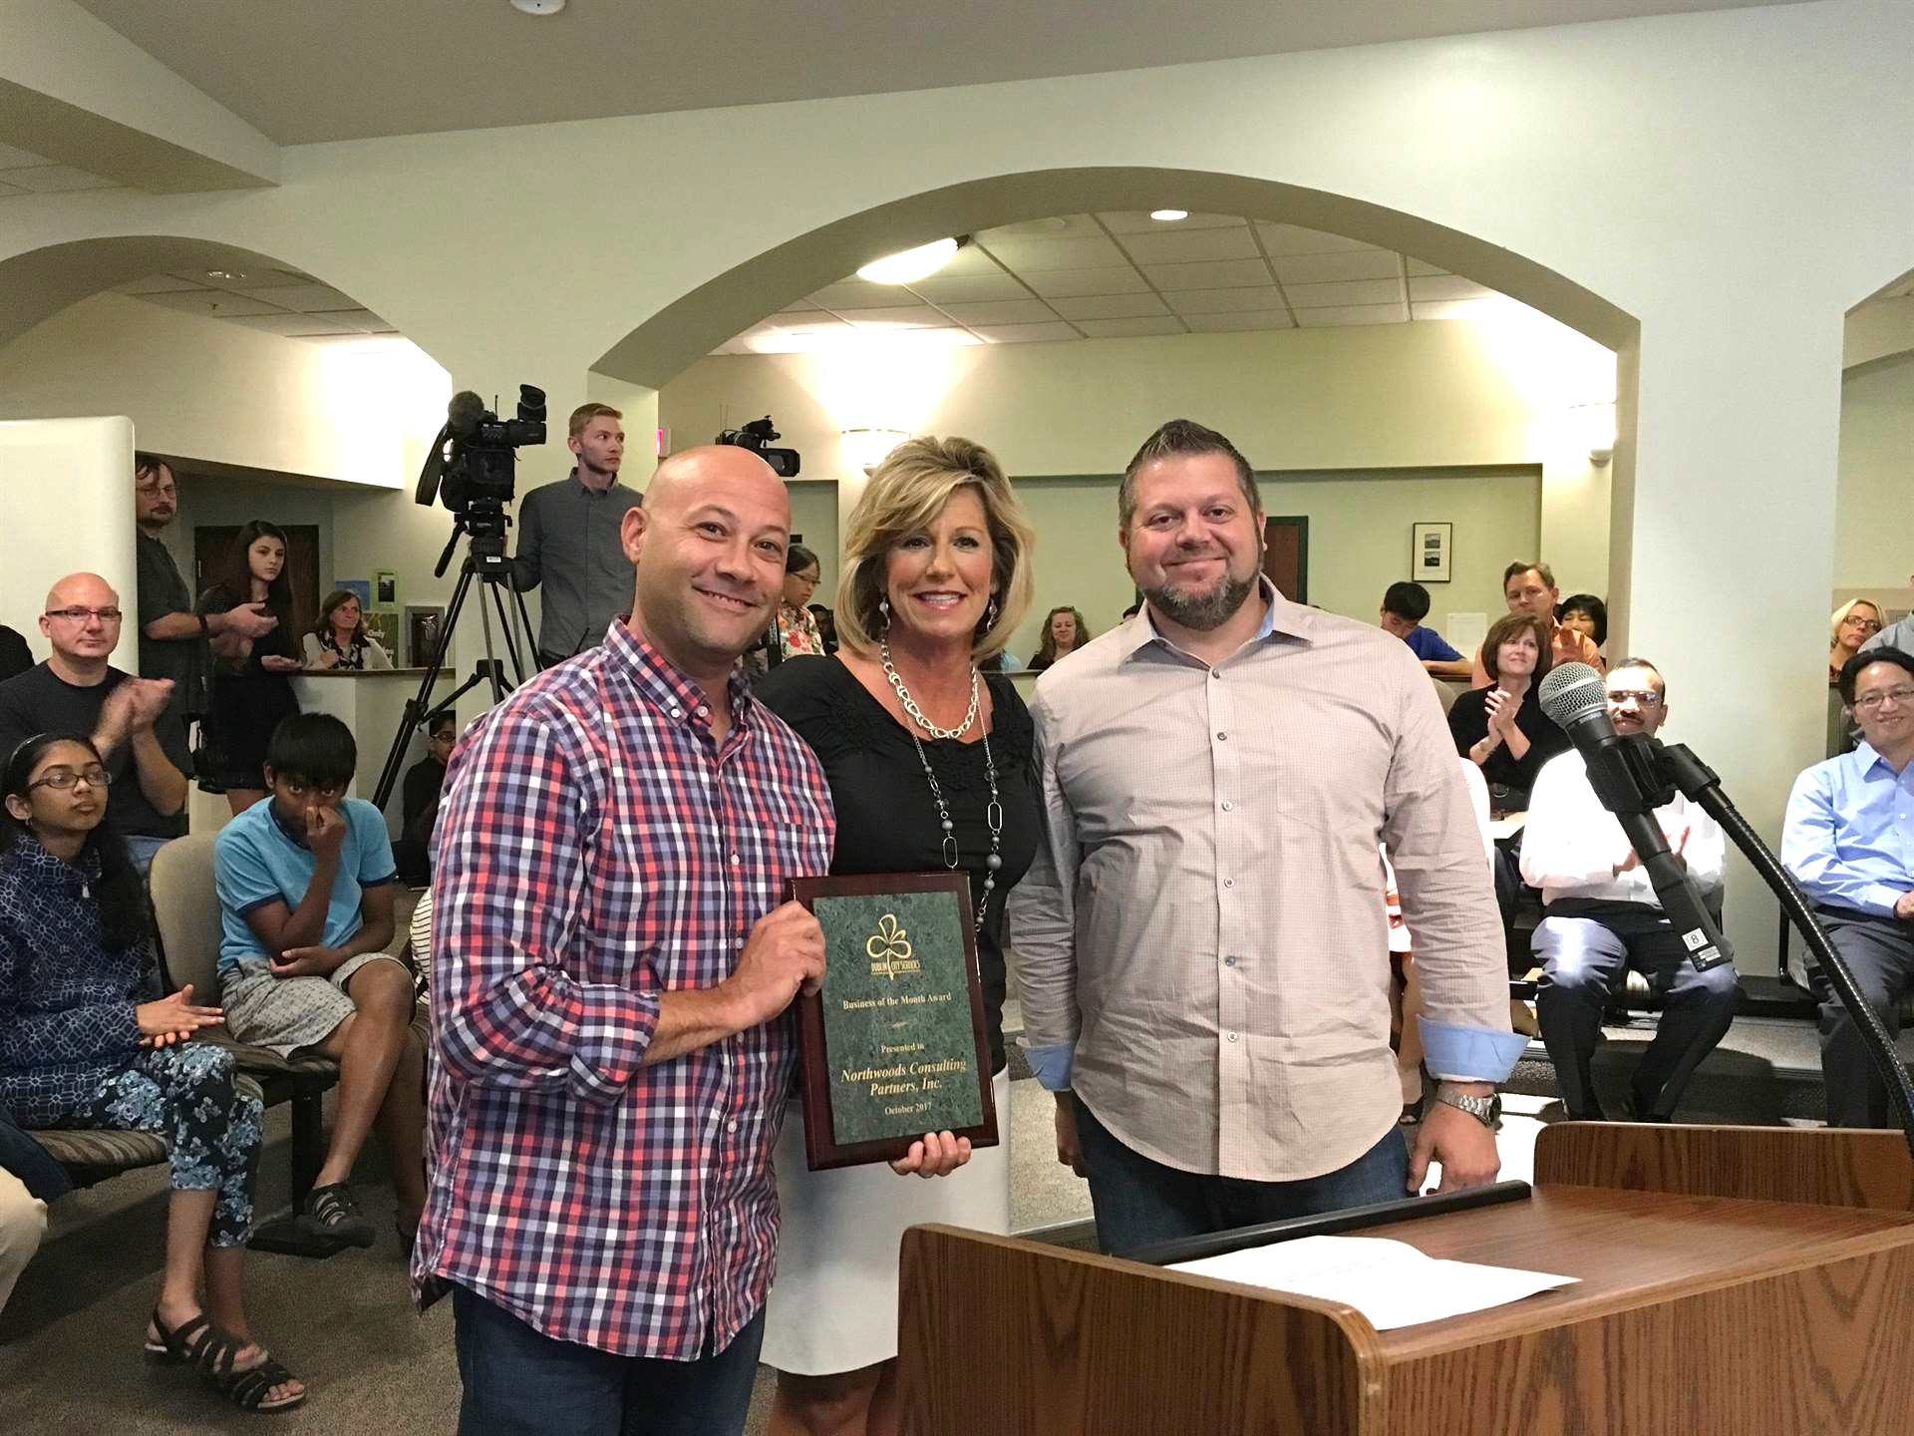
Building Relationships | Northwoods Consulting Partners
Finding the right talent
Contractors/FTEs
  TEK Systems – Finding the “Purple Squirrels”
  Tech Elevator – New coders/software developers
Interns
  City of Dublin Schools IT Academy – development interns
  Ohio State College of Social Work – social worker interns
  Business of Software Internship Program – OU, OSU
Dublin City Schools presents Northwoods Consulting Partners Business of the Month Award for partnership with the
DCS/Tolles IT Academy
Small, Meaningful Wins

Slide 22
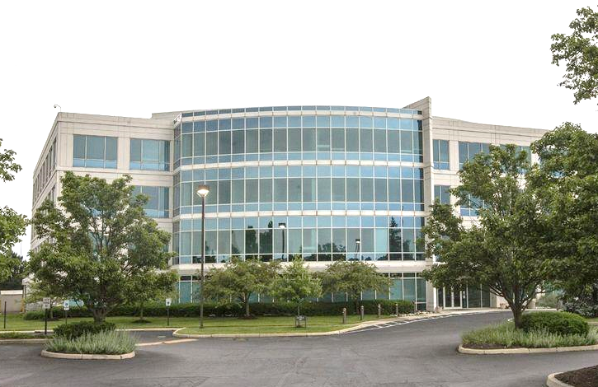
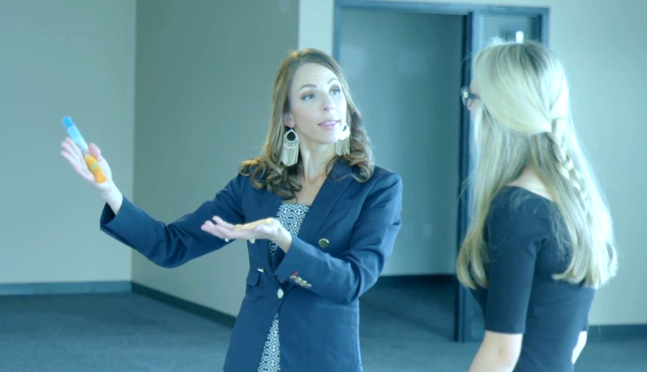
Building Relationships | Dublin City Schools Emerald Campus
Campus opening for classes August 2018
The Ask: Finding Professional Partners (businesses & individuals) to serve as resources and help identify projects for students to work on
Dublin Economic Development’s Response: 11+ company introductions made
CISCO systems developing academy whose graduates will earn two job-ready credentials
Automotive engineering company DENSO donating $5,000 grant
Dublin City Schools Emerald Campus Director
Kristy Venne is meeting with community members and businesses to explore innovative career exploration partnerships
Small, Meaningful Wins

Slide 23
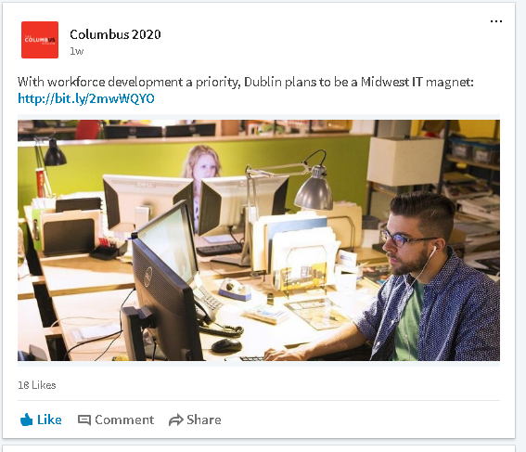
“Singles & Doubles”
Sharing job posts on LinkedIn, Twitter
Design Thinking workshop at Persistent Systems
Ardina
  Code from Student 1 was actually put into production on a project.
  Student 2 was able to assist in troubleshooting a source code issue on a project based on his more recent mathematical skills.
Wilke Global Donates Funds to Support STEM Education at Davis Middle School
Small, Meaningful Wins

Slide 24
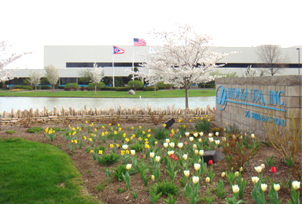
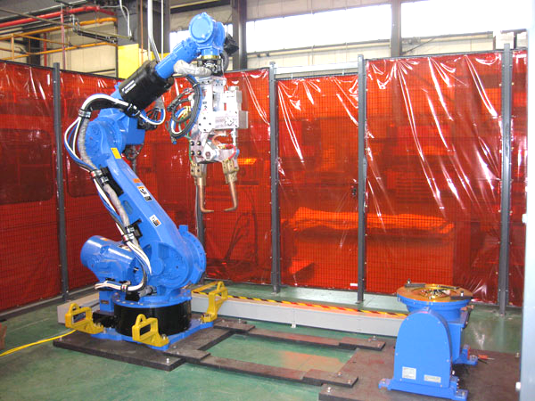
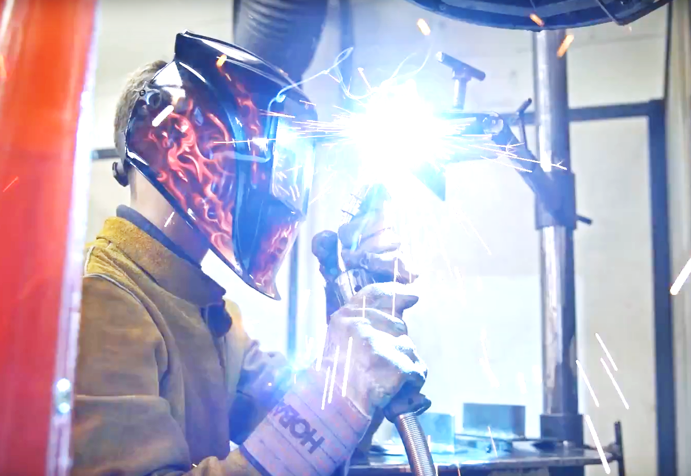

Scaling the Program – Beyond I.T. | Hidaka USA
The Need: Welders at Hidaka USA (automotive manufacturing & prototyping)
The Source: Tolles
The Facilitator: Dublin Economic Development
Two interns from Tolles welding program started in March 2018
Lessons Learned
  Relationships built – connections
  Scale – opportunity to become a “model” program
  Try something!
Small, Meaningful Wins

Slide 25




















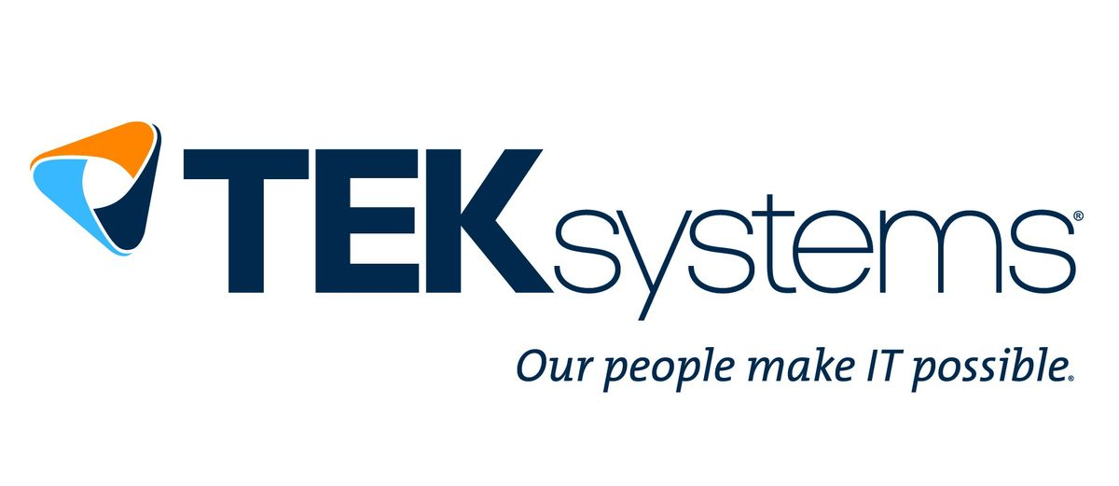

Thinking Regionally | Building a network of partners
Creating buzz around Dublin’s sustainable system for workforce development.
Our partners know when, why, and how to engage our team and our network.
Ready to connect partners and stakeholders with programs, people, and resources.
Workforce Development Champions

Slide 26
Key Messages: How Does Dublin Make I.T. Happen?
Focus
Small Wins
Try something!
Find your community’s workforce development champion(s).
If you don’t know where to start, start with your local Economic Development partners.

Slide 27

What do you do now?
Engage with us and keep the conversation and momentum going.
→ be a part of our team and solution!
Share with us: How will you help make the Columbus Region a network of SuccessBound communities? What take-aways from this presentation will you apply in your community/network?
rray@dublin.oh.us

Slide 28
Thank You!
EconDev.DublinOhioUSA.gov
Rachel Ray, Economic Development Administrator
rray@dublin.oh.us / (614) 410-4630
@CMHRach
Rachel Ray, AICP

